Slide 1
IPV4
IP Addressing
Subnetting
IPV6
ARP
RARP
ICMP
DHCP

Slide 2
Network Layer: Internet
host, router network layer functions:
transport layer: TCP, UDP
IP protocol
datagram format
addressing
packet handling conventions
Path-selection algorithms: implemented in
routing protocols (OSPF, BGP)
SDN controller
network
layer
forwarding
table
ICMP protocol
error reporting
router “signaling”
link layer
physical layer

Slide 3
IP Datagram format
32 bits
IP protocol version number
head.
len
type of
service
total datagram
length (bytes)
header length(bytes)
ver
length
“type” of service:
diffserv (0:5)
ECN (6:7)
16-bit identifier
flgs
fragment
offset
fragmentation/
reassembly
time to
live
upper
layer
header
checksum
header checksum
TTL: remaining max hops
(decremented at each router)
source IP address
32-bit source IP address
destination IP address
Maximum length: 64K bytes
Typically: 1500 bytes or less
upper layer protocol (e.g., TCP or UDP)
32-bit destination IP address
overhead
options (if any)
e.g., timestamp, record route taken
20 bytes of TCP
20 bytes of IP
= 40 bytes + app layer overhead for TCP+IP
payload data
(variable length,
typically a TCP
or UDP segment)

Slide 4

IP addressing: introduction
223.1.1.1
IP address:
32-bit identifier associated with each host or router interface
interface:
connection between host/router and physical link
router’s typically have multiple interfaces
host typically has one or two interfaces (e.g., wired Ethernet, wireless 802.11)
IP Address is divided into two parts:
Network part(prefix): The prefix part of IP address identifies the physical network to which the computer is attached. . Prefix is also known as a network address.
Host part(Suffix): The suffix part identifies the individual computer on the network. The suffix is also called the host address.
223.1.2.1
223.1.1.2
223.1.1.4
223.1.2.9
223.1.1.3
223.1.3.27
223.1.2.2
223.1.3.1
223.1.3.2
dotted-decimal IP address notation:
223.1.1.1 = 11011111 00000001 00000001 00000001
223
1
1
1
Network part
Host part

Slide 5
IP Header Classes
Class | Address Range | Subnet masking | Example IP | Leading bits | Max number of networks | Application
Class A | 1 to 126 | 255.0.0.0 | 1.1.1.1 | 8 | 128 | Used for large number of hosts.
Class B | 128 to 191 | 255.255.0.0 | 128.1.1.1 | 16 | 16384 | Used for medium size network.
Class C | 192 to 223 | 255.255.255.0 | 192.1.11. | 24 | 2097157 | Used for local area network.
Class D | 224 to 239 | NA | NA | NA | NA | Reserve for multi-tasking.
Class E | 240 to 254 | NA | NA | NA | NA | This class is reserved for research and Development Purposes.
127 is not used.

Slide 6
IP Address Types:
Public IP address
A public IP address is an Internet Protocol address, encrypted by various servers/devices. That’s when you connect these devices with your internet connection. The web server, email server, and any server device that has direct access to the Internet are those who will enter the public Internet Protocol address. Internet Address Protocol is unique worldwide and is only supplied with a unique device.
Private IP address
Everything that connects to your Internet network has a private IP address. This includes computers, smartphones, and tablets but also any Bluetooth-enabled devices such as speakers, printers, or smart TVs. With the growing internet of things, the number of private IP addresses you have at home is likely to increase. Your router needs a way to identify these things separately, and most things need a way to get to know each other. Therefore, your router generates private IP addresses that are unique identifiers for each device that separates the network.
Static IP Address
A static IP address is an invalid IP address. Conversely, a dynamic IP address will be provided by the Dynamic Host Configuration Protocol (DHCP) server, which can change. The Static IP address does not change but can be changed as part of normal network management.
Static IP addresses are incompatible, given once, remain the same over the years. This type of IP also helps you get more information about the device.
Dynamic IP address
It means constant change. A dynamic IP address changes from time to time and is not always the same. If you have a live cable or DSL service, you may have a strong IP address. Internet Service Providers provide customers with dynamic IP addresses because they are too expensive. Instead of one permanent IP address, your IP address is taken out of the address pool and assigned to you. After a few days, weeks, or sometimes even months, that number is returned to the lake and given a new number. Most ISPs will not provide a static IP address to customers who live there and when they do, they are usually more expensive.

Slide 7
Types of Website IP address:
Dedicated IP address
A dedicated IP address is one that is unique for each website. This address is not used by any other domain. A dedicated IP address is beneficial in many ways. It provides increased speed when the traffic load is high and brings in increased security. But dedicated IPs are costly as compared to shared IPs.
Shared IP address
A shared IP address is one that is not unique. It is shared between multiple domains. A shared IP address is enough for most users because common configurations don’t require a dedicated IP.

Slide 8
IP Address Classification Based on Operational Characteristics:
Broadcast addressing
The term ‘Broadcast’ means to transmit audio or video over a network. A broadcast packet is sent to all users of a local network at once. They do not have to be explicitly named as recipients. The users of a network can open the data packets and then interpret the information, carry out the instructions or discard it. This service is available in IPv4. The IP address commonly used for broadcasting is 255.255.255.255
Unicast addressing
This address identifies a unique node on the network. Unicast is nothing but one-to-one data transmission from one point in the network to another. It is the most common form of IP addressing. This method can be used for both sending and receiving data. It is available in IPv4 and IPv6.
Multicast IP addresses
These IP addresses mainly help to establish one-to-many communication. Multicast IP routing protocols are used to distribute data to multiple recipients.
The class D addresses (224.0.0.0 to 239.255.255.255) define the multicast group.
Anycast addressing
In anycast addressing the data, a packet is not transmitted to all the receivers on the network. When a data packet is allocated to an anycast address, it is delivered to the closest interface that has this anycast address.

Slide 9
Subnets
subnet mask: /24
(high-order 24 bits: subnet part of IP address)
What’s a subnet ?
Subnet break large network into smaller, more manageable networks that run efficiently.
Router connect different subnetworks
network consisting of 3 subnets
subnet 223.1.1.0/24
223.1.1.1
subnet 223.1.2.0/24
223.1.2.1
223.1.1.2
223.1.1.4
IP addresses have structure:
subnet part/network id:
It is the part of the left-hand IP address that identifies the specific network where the device is located.
Detach each interface from its host or router, creating “islands” of isolated networks. each isolated network is called a subnet
Devices in same subnet have common high order bits.
host part:
remaining low order bits identify the host in that network.
223.1.2.9
223.1.1.3
223.1.3.27
223.1.2.2
subnet
223.1.3.0/24
223.1.3.1
223.1.3.2
dotted-decimal IP address notation:
223.1.1.1 = 11011111 00000001 00000001 00000001
223
1
1
1
Network part
Host part

Slide 10
Subnets
223.1.1.2
subnet 223.1.1/24
where are the subnets?
what are the /24 subnet addresses?
223.1.1.1
223.1.1.4
223.1.1.3
223.1.9.2
223.1.7.0
subnet 223.1.7/24
subnet 223.1.9/24
223.1.9.1
223.1.7.1
223.1.8.1
223.1.8.0
subnet 223.1.2/24
223.1.2.6
subnet 223.1.8/24
223.1.3.27
subnet 223.1.3/24
Subnet Mask:
It is used to find which IP address belongs to which Subnet.
It is a 32 bit number, containing 0’s and 1’s.
Here network id part and Subnet ID part is represented by all 1’s and host ID part is represented by all 0’s.
223.1.2.1
223.1.2.2
223.1.3.1
223.1.3.2
Default subnet masks of class a, b &c.
Class a: 255.0.0.0
Class b: 255.255.0.0
Class c: 255.255.255.0

Slide 11
IP addressing: CIDR
CIDR: Classless InterDomain Routing (pronounced “cider”)
subnet portion of address of arbitrary length
address format: a.b.c.d/x, where x is # bits in subnet portion of address
subnet
part
host
part
11001000 00010111 00010000 00000000
200.23.16.0/23

Slide 12
IP addresses: how to get one?
That’s actually two questions:
Q: How does a host get IP address within its network (host part of address)?
Q: How does a network get IP address for itself (network part of address)
How does host get IP address?
hard-coded by sysadmin in config file (e.g., /etc/rc.config in UNIX)
DHCP: Dynamic Host Configuration Protocol: dynamically get address from as server
“plug-and-play”

Slide 13
IP addresses: how to get one?
Q: how does network get subnet part of IP address?
A: gets allocated portion of its provider ISP’s address space
ISP's block 11001000 00010111 00010000 00000000 200.23.16.0/20
ISP can then allocate out its address space in 8 blocks:
Organization 0 11001000 00010111 00010000 00000000 200.23.16.0/23
Organization 1 11001000 00010111 00010010 00000000 200.23.18.0/23
Organization 2 11001000 00010111 00010100 00000000 200.23.20.0/23
... ….. …. ….
Organization 7 11001000 00010111 00011110 00000000 200.23.30.0/23

Slide 14
IP addressing:
Q: how does an ISP get block of addresses?
A: ICANN: Internet Corporation for Assigned Names and Numbers http://www.icann.org/
allocates IP addresses, through 5 regional registries (RRs) (who may then allocate to local registries)
manages DNS root zone, including delegation of individual TLD (.com, .edu , …) management
Q: are there enough 32-bit IP addresses?
ICANN allocated last chunk of IPv4 addresses to RRs in 2011
NAT (next) helps IPv4 address space exhaustion
IPv6 has 128-bit address space
"Who the hell knew how much address space we needed?" Vint Cerf (reflecting on decision to make IPv4 address 32 bits long)

Slide 15

NAT: network address translation
NAT: all devices in local network share just one IPv4 address as far as outside world is concerned
rest of
Internet
local network (e.g., home network) 10.0.0/24
138.76.29.7
10.0.0.4
10.0.0.1
10.0.0.2
10.0.0.3
all datagrams leaving local network have same source NAT IP address: 138.76.29.7, but different source port numbers
datagrams with source or destination in this network have 10.0.0/24 address for source, destination (as usual)

Slide 16
NAT: network address translation
Network Address Translation (NAT) is a process in which one or more local IP address is translated into one or more Global IP address and vice versa in order to provide Internet access to the local hosts. NAT generally operates on a router or firewall.
all devices in local network have 32-bit addresses in a “private” IP address space (10/8, 172.16/12, 192.168/16 prefixes) that can only be used in local network
advantages:
just one IP address needed from provider ISP for all devices
can change addresses of host in local network without notifying outside world
can change ISP without changing addresses of devices in local network
security: devices inside local net not directly addressable, visible by outside world

Slide 17
NAT: network address translation
implementation: NAT router must (transparently):
outgoing datagrams: replace (source IP address, port #) of every outgoing datagram to (NAT IP address, new port #)
remote clients/servers will respond using (NAT IP address, new port #) as destination address
remember (in NAT translation table) every (source IP address, port #) to (NAT IP address, new port #) translation pair
incoming datagrams: replace (NAT IP address, new port #) in destination fields of every incoming datagram with corresponding (source IP address, port #) stored in NAT table

Slide 18
NAT: network address translation
NAT translation table
WAN side addr LAN side addr
2: NAT router changes datagram source address from 10.0.0.1, 3345 to 138.76.29.7, 5001,
updates table
1: host 10.0.0.1 sends datagram to 128.119.40.186, 80
138.76.29.7, 5001 10.0.0.1, 3345
…… ……
S: 10.0.0.1, 3345
D: 128.119.40.186, 80
1
10.0.0.1
2
S: 138.76.29.7, 5001
D: 128.119.40.186, 80
10.0.0.4
10.0.0.2
138.76.29.7
S: 128.119.40.186, 80
D: 10.0.0.1, 3345
4
S: 128.119.40.186, 80
D: 138.76.29.7, 5001
3
10.0.0.3
3: reply arrives, destination address: 138.76.29.7, 5001

Slide 19
NAT: network address translation
NAT has been controversial:
routers “should” only process up to layer 3
address “shortage” should be solved by IPv6
violates end-to-end argument (port # manipulation by network-layer device)
NAT traversal: what if client wants to connect to server behind NAT?
but NAT is here to stay:
extensively used in home and institutional nets, 4G/5G cellular nets

Slide 20
IPv6: motivation
initial motivation: 32-bit IPv4 address space would be completely allocated
additional motivation:
speed processing/forwarding: 40-byte fixed length header
enable different network-layer treatment of “flows”

Slide 21
IPv6 datagram format
flow label: identify datagrams in same "flow.” (concept of “flow” not well defined).
priority: identify priority among datagrams in flow
32 bits
ver
pri
flow label
payload len
next hdr
hop limit
source address
(128 bits)
128-bit
IPv6 addresses
destination address
(128 bits)
payload (data)
What’s missing (compared with IPv4):
no checksum (to speed processing at routers)
no fragmentation/reassembly
no options (available as upper-layer, next-header protocol at router)

Slide 22
Transition from IPv4 to IPv6
not all routers can be upgraded simultaneously
no “flag days”
how will network operate with mixed IPv4 and IPv6 routers?
encapsulation: wrapping a packet inside another packet
tunneling: IPv6 datagram carried as payload in IPv4 datagram among IPv4 routers (“packet within a packet”)
Tunneling is a way to move packets from one network to another
tunneling used extensively in other contexts (4G/5G)
IPv4 header fields
IPv6 header fields
IPv4 payload
IPv4 source, dest addr
IPv6 source dest addr
UDP/TCP payload
IPv6 datagram
IPv4 datagram

Slide 23
Tunneling and encapsulation
Ethernet connecting two IPv6 routers:
A
B
Ethernet connects two IPv6 routers
E
F
IPv6
IPv6
IPv6
IPv6
IPv6 datagram
Link-layer frame
The usual: datagram as payload in link-layer frame
IPv4 network connecting two IPv6 routers
A
B
E
F
IPv6
IPv6/v4
IPv6/v4
IPv6
IPv4 network

Slide 24
Tunneling and encapsulation
Ethernet connecting two IPv6 routers:
A
B
Ethernet connects two IPv6 routers
E
F
IPv6
IPv6
IPv6
IPv6
IPv6 datagram
Link-layer frame
The usual: datagram as payload in link-layer frame
IPv4 tunnel connecting two IPv6 routers
A
B
IPv4 tunnel
connecting IPv6 routers
E
F
IPv6
IPv6/v4
IPv6/v4
IPv6
IPv6 datagram
IPv4 datagram
tunneling: IPv6 datagram as payload in a IPv4 datagram

Slide 25
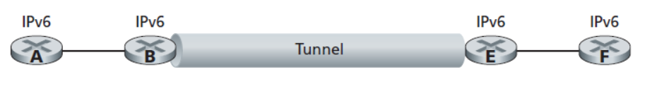
Tunneling
A
B
IPv4 tunnel
connecting IPv6 routers
E
F
logical view:
IPv6
IPv6/v4
IPv6/v4
IPv6
A
B
C
D
E
F
physical view:
IPv6
IPv6/v4
IPv4
IPv4
IPv6/v4
IPv6
flow: X
src: A
dest: F
data
src:B
dest: E
src:B
dest: E
src:B
dest: E
flow: X
src: A
dest: F
data
Flow: X
Src: A
Dest: F
data
Flow: X
Src: A
Dest: F
data
Flow: X
Src: A
Dest: F
data
Note source and destination addresses!
A-to-B:
IPv6
B-to-C:
IPv6 inside
IPv4
B-to-C:
IPv6 inside
IPv4
B-to-C:
IPv6 inside
IPv4
E-to-F:
IPv6

Slide 26
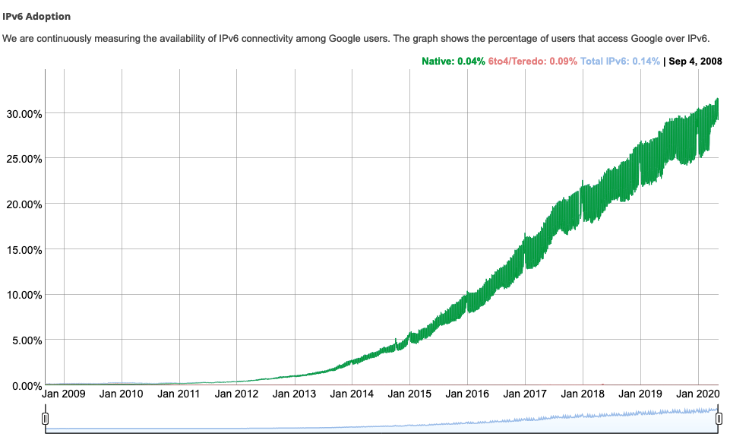
IPv6: adoption
Google¹: ~ 30% of clients access services via IPv6
NIST: 1/3 of all US government domains are IPv6 capable
¹ https://www.google.com/intl/en/ipv6/statistics.html

Slide 27
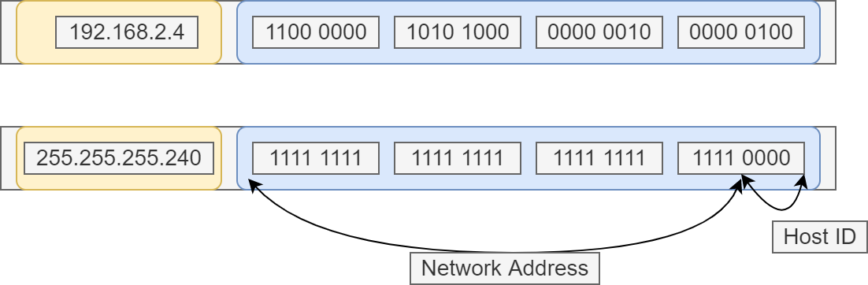
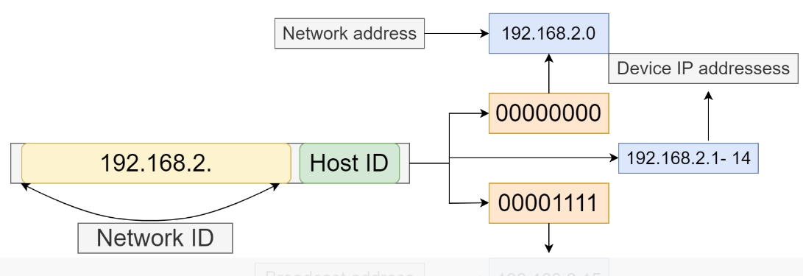
Determining Network and Broadcast Address
Let’s take an example for calculating network and broadcast addresses using a subnet mask. Now, in order to calculate network and broadcast addresses, we need two pieces of information: the IP address of the device and the subnet mask of the network.
Let’s assume the IP address is 198.168.2.4 and
the subnet mask is 255.255.255.240 .
The first step is to write down the IP address and subnet mask in binary
Bits in the subnet mask which are 1 denotes the network address.
Similarly, the bits which are 0 will be used for the broadcast address:

Slide 28
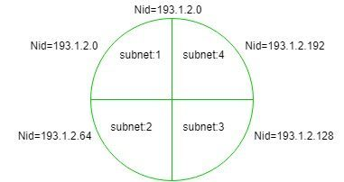
Finding Network ID of a Subnet (using Subnet Mask)
Subnet Mask:
It is used to find which IP address belongs to which Subnet. It is a 32 bit number, containing 0’s and 1’s. Here network id part and Subnet ID part is represented by all 1’s and host ID part is represented by all 0’s.
Example: If Network id of a entire network = 193.1.2.0 (it is class C IP).
Subnet-1: 193.1.2.0 to 193.1.2.63
Subnet-2: 193.1.2.64 to 193.1.2.127
Subnet-3: 193.1.2.128 to 193.1.2.191
Subnet-4: 193.1.2.192 to 193.1.2.255
The above IP is class C, so it has 24 bits in network id part and 8 bits in host id part but choose two bits for subnet id from host id part, so now there are two bits in subnet id part and six bits in host id part, i.e.,
24 bits in network id + 2 bits in subnet id = 26 (1's) and 6 bits in host id = 6 (0's) Therefore,
Subnet Mask = 11111111.11111111.11111111.11000000 = 255.255.255.192

Slide 29
If any given IP address performs bit wise AND operation with the subnet mask, then you get the network id of the subnet to which the given IP belongs
Example-1:
If IP address = 193.1.2.129 (convert it into binary form) =
11000001.00000001.00000010.10000001
Subnet mask = 111111 11.11111 1 11.111111 11.110000 00
Bit Wise AND = 11000001.00000001.00000010.10000000
Therefore, Nid = 193.1.2.128
Hence, this IP address belongs to subnet:3 which has Nid = 193.1.2.128

Slide 30
Example 2
If IP address = 193.1.2.67
(convert it into binary form) = 11000001.00000001.00000010.01000011
Subnet Mask = 11111111.11111111.11111111.11000000
Bit Wise AND = 11000001.00000001.00000010.01000000
Therefore, Nid = 193.1.2.64
Hence, this IP address belongs to subnet:2 which has Nid = 193.1.2.64

Slide 31
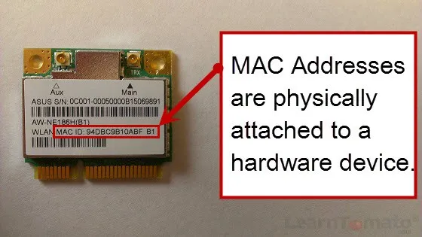
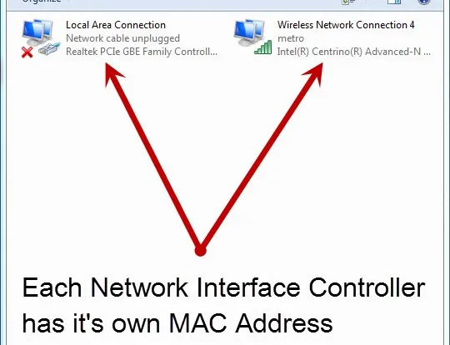
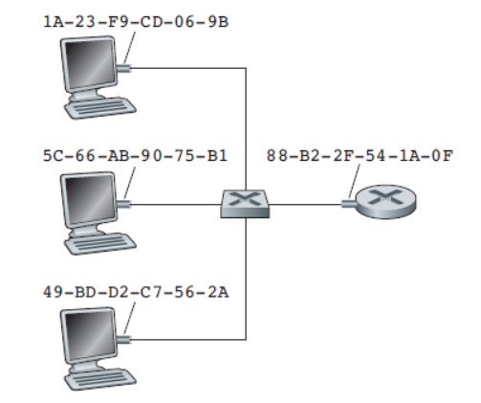
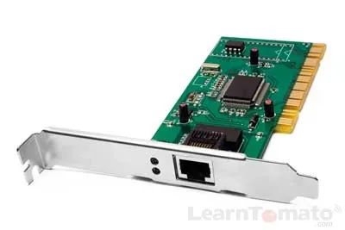
MAC
A link-layer address is variously called a LAN address, a physical address, or a MAC address.
function: used ‘locally” to get frame from one interface to another physically-connected interface (same network, in IP-addressing sense)
For most LANs (including Ethernet and 802.11 wireless LANs), the MAC address is 6 bytes long, giving 2 power(48) possible MAC addresses.
6-byte(48 bits) addresses are expressed in hexadecimal notation, with each byte of the address expressed as a pair of hexadecimal numbers.

Slide 32
When an adapter wants to send a frame to some destination adapter, the sending adapter inserts the destination adapter’s MAC address into the frame and then sends the frame into the LAN.
A switch broadcasts an incoming frame onto all of its interfaces. Thus, an adapter may receive a frame that isn’t addressed to it.
Thus, when an adapter receives a frame, it will check to see whether the destination MAC address in the frame matches its own MAC address. If there is a match, the adapter extracts the enclosed datagram and passes the datagram up the protocol stack.
If there isn’t a match, the adapter discards the frame, without passing the network-layer datagram up. Thus, the destination only will be interrupted when the frame is received.
Sometimes a sending adapter does want all the other adapters on the LAN to receive and process the frame it is about to send. In this case, the sending adapter inserts a special MAC broadcast address into the destination address field of the frame. For LANs that use 6-byte addresses (such as Ethernet and 802.11), the broadcast address is a string of 48 consecutive 1s (that is, FF-FF-FF-FF-FFFF in hexadecimal notation).

Slide 33
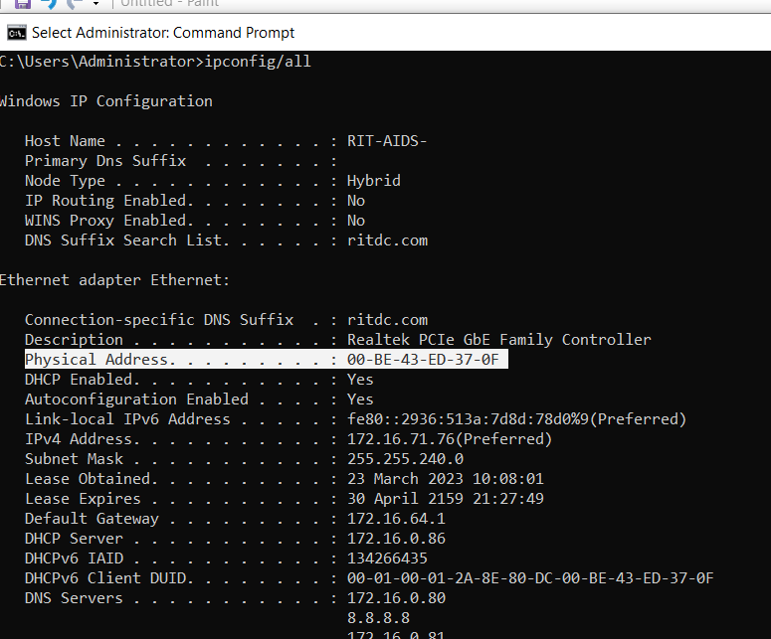

Slide 34
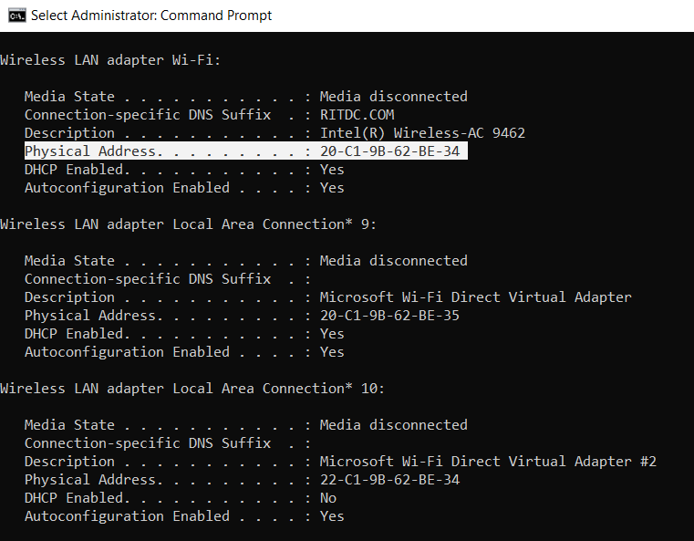

Slide 35
Comparison of MAC & IP address
MAC address allocation administered by IEEE
analogy:
MAC address: like Social Security Number
IP address: like postal address
MAC flat address ➜ portability
can move LAN card from one LAN to another
IP hierarchical address not portable
address depends on IP subnet to which node is attached

Slide 36
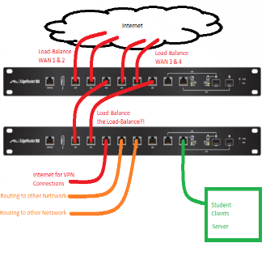

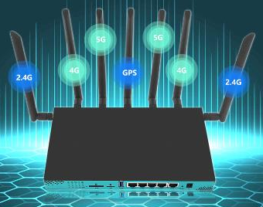
LAN addresses and ARP
each adapter on LAN has unique LAN address
adapter
1A-2F-BB-76-09-AD
LAN
(wired or
wireless)
71-65-F7-2B-08-53
58-23-D7-FA-20-B0
0C-C4-11-6F-E3-98

Slide 37
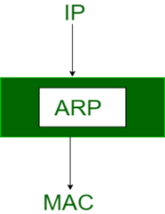
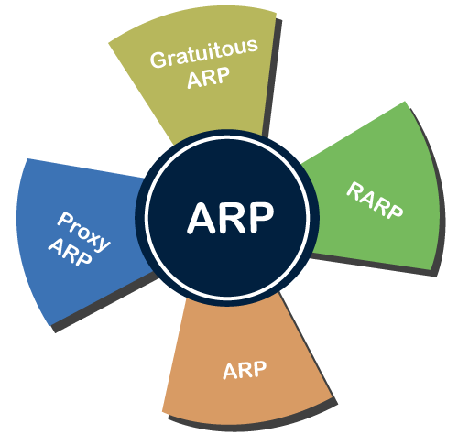
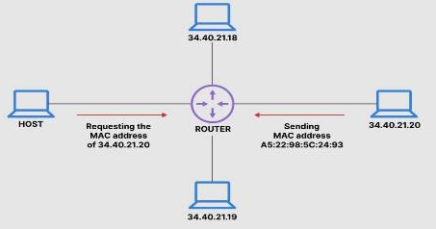
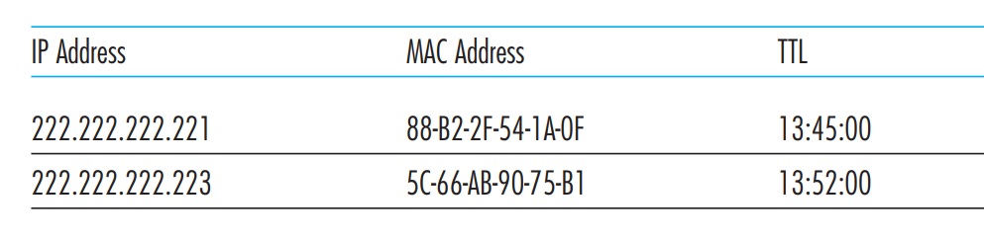
ARP: address resolution protocol
ARP stands for (Address Resolution Protocol). It is responsible to find the hardware address of a host from a known IP address
ARP table: each IP node (host, router) on LAN has table
IP/MAC address mappings for some LAN nodes:
< IP address; MAC address; TTL>
TTL (Time To Live): time after which address mapping will be forgotten (typically 20 min)

Slide 38
ARP protocol: same LAN or ARP in Layer 2 network
A wants to send datagram to B
B’s MAC address not in A’s ARP table.
A broadcasts ARP query packet, containing B's IP address
destination MAC address = FF-FF-FF-FF-FF-FF
all nodes on LAN receive ARP query
B receives ARP packet, replies to A with its (B's) MAC address
frame sent to A’s MAC address (unicast)
A caches (saves) IP-to-MAC address pair in its ARP table until information becomes old (times out)
soft state: information that times out (goes away) unless refreshed
ARP is “plug-and-play”:
nodes create their ARP tables without intervention from net administrator

Slide 39
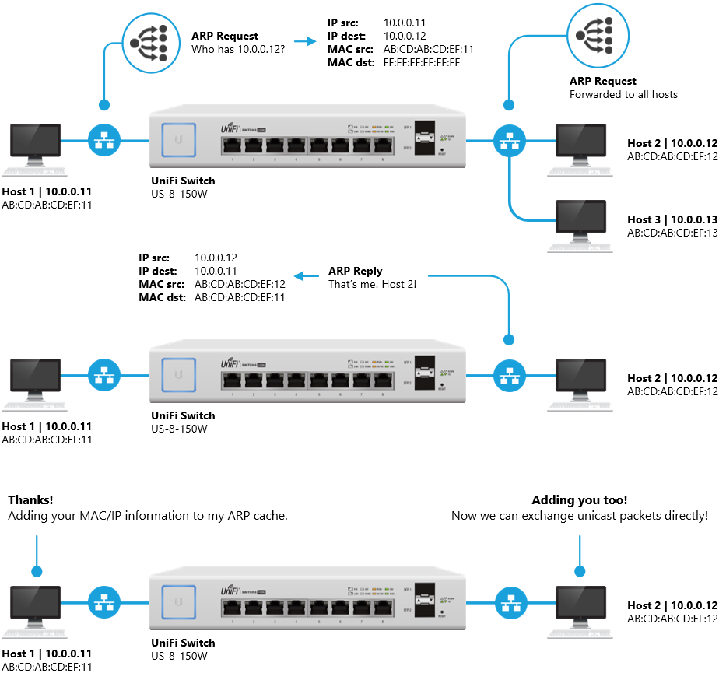
ARP protocol: same LAN or ARP in Layer 2 network
A Layer 2 switch works with MAC addresses only and does not care about IP address
same LAN
same LAN
same LAN
Intro to Networking - Address Resolution Protocol (ARP) – Ubiquiti Support and Help Center

Slide 40




Addressing: routing to another LAN or ARP in Layer 3 network or Proxy ARP
Layer 3 switch, or multilayer switch, can do all the job of a layer 2 switch and additional static routing and dynamic routing as well
Subnet 1 would send a datagram to a host on Subnet 2. Specifically, suppose that host 111.111.111.111 wants to send an IP datagram to a host 222.222.222.222.
walkthrough: send datagram from A to B via R
focus on addressing – at IP (datagram) and MAC layer (frame)
assume A knows B’s IP address
assume A knows IP address of first hop router, R (how?)
assume A knows R’s MAC address (how?)
ARP for MAC
A
B
Forwarding table for routing, ARP for MAC
R
111.111.111.111
222.222.222.222
74-29-9C-E8-FF-55
49-BD-D2-C7-56-2A
222.222.222.220
1A-23-F9-CD-06-9B
111.111.111.112
111.111.111.110
222.222.222.221
CC-49-DE-D0-AB-7D
E6-E9-00-17-BB-4B
88-B2-2F-54-1A-0F
Subnet 2 222.222.222.xxx
Subnet 1 111.111.111.xxx

Slide 41
Addressing: routing to another LAN or ARP in Layer 3 network or Proxy ARP
A creates IP datagram with IP source A, destination B
A creates link-layer frame with R's MAC address as destination address, frame contains A-to-B IP datagram
MAC src: 74-29-9C-E8-FF-55
MAC dest: E6-E9-00-17-BB-4B
IP
Eth
Phy
IP src: 111.111.111.111
IP dest: 222.222.222.222
A
B
R
111.111.111.111
222.222.222.222
74-29-9C-E8-FF-55
49-BD-D2-C7-56-2A
222.222.222.220
1A-23-F9-CD-06-9B
111.111.111.112
111.111.111.110
222.222.222.221
CC-49-DE-D0-AB-7D
E6-E9-00-17-BB-4B
88-B2-2F-54-1A-0F

Slide 42
Addressing: routing to another LAN or ARP in Layer 3 network or Proxy ARP
frame sent from A to R
frame received at R, datagram removed, passed up to IP
MAC src: 74-29-9C-E8-FF-55
MAC dest: E6-E9-00-17-BB-4B
IP src: 111.111.111.111
IP dest: 222.222.222.222
IP
Eth
Phy
IP src: 111.111.111.111
IP dest: 222.222.222.222
IP
Eth
Phy
A
B
R
111.111.111.111
222.222.222.222
74-29-9C-E8-FF-55
49-BD-D2-C7-56-2A
222.222.222.220
1A-23-F9-CD-06-9B
111.111.111.112
111.111.111.110
222.222.222.221
CC-49-DE-D0-AB-7D
E6-E9-00-17-BB-4B
88-B2-2F-54-1A-0F

Slide 43
Addressing: routing to another LAN or ARP in Layer 3 network or Proxy ARP
R forwards datagram with IP source A, destination B
R creates link-layer frame with B's MAC address as destination address, frame contains A-to-B IP datagram
MAC src: 1A-23-F9-CD-06-9B
MAC dest: 49-BD-D2-C7-56-2A
IP
Eth
Phy
IP
Eth
Phy
IP src: 111.111.111.111
IP dest: 222.222.222.222
A
B
R
111.111.111.111
222.222.222.222
74-29-9C-E8-FF-55
49-BD-D2-C7-56-2A
222.222.222.220
1A-23-F9-CD-06-9B
111.111.111.112
111.111.111.110
222.222.222.221
CC-49-DE-D0-AB-7D
E6-E9-00-17-BB-4B
88-B2-2F-54-1A-0F

Slide 44
Addressing: routing to another LAN or ARP in Layer 3 network or Proxy ARP
R forwards datagram with IP source A, destination B
R creates link-layer frame with B's MAC address as destination address, frame contains A-to-B IP datagram
MAC src: 1A-23-F9-CD-06-9B
MAC dest: 49-BD-D2-C7-56-2A
IP
Eth
Phy
IP
Eth
Phy
IP src: 111.111.111.111
IP dest: 222.222.222.222
A
B
R
111.111.111.111
222.222.222.222
74-29-9C-E8-FF-55
49-BD-D2-C7-56-2A
222.222.222.220
1A-23-F9-CD-06-9B
111.111.111.112
111.111.111.110
222.222.222.221
CC-49-DE-D0-AB-7D
E6-E9-00-17-BB-4B
88-B2-2F-54-1A-0F

Slide 45
Addressing: routing to another LAN or ARP in Layer 3 network or Proxy ARP
R forwards datagram with IP source A, destination B
R creates link-layer frame with B's MAC address as dest, frame contains A-to-B IP datagram
MAC src: 1A-23-F9-CD-06-9B
MAC dest: 49-BD-D2-C7-56-2A
IP src: 111.111.111.111
IP dest: 222.222.222.222
IP
Eth
Phy
A
B
R
111.111.111.111
222.222.222.222
74-29-9C-E8-FF-55
49-BD-D2-C7-56-2A
222.222.222.220
1A-23-F9-CD-06-9B
111.111.111.112
111.111.111.110
222.222.222.221
CC-49-DE-D0-AB-7D
E6-E9-00-17-BB-4B
88-B2-2F-54-1A-0F
* Check out the online interactive exercises for more examples: http://gaia.cs.umass.edu/kurose_ross/interactive/

Slide 46
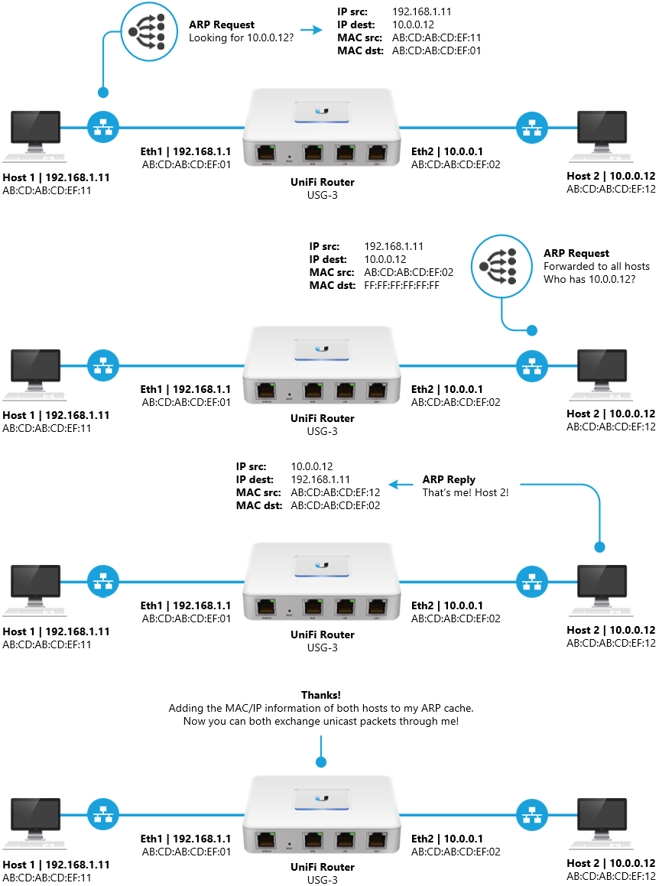
Addressing: routing to another LAN or ARP in Layer 3 network or ProxyARP

Slide 47

CASE-1: The sender is a host and wants to send a packet to another host on the same network.
Use ARP to find another host’s physical address
CASE-2: The sender is a host and wants to send a packet to another host on another network.
The sender looks at its routing table.
Find the IP address of the next-hop (router) for this destination.
Use ARP to find the router’s physical address
CASE-3: the sender is a router and received a datagram destined for a host on another network.
The router checks its routing table.
Find the IP address of the next router.
Use ARP to find the next router’s physical address.
CASE-4: The sender is a router that has received a datagram destined for a host in the same network.
Use ARP to find this host’s physical address.

Slide 48
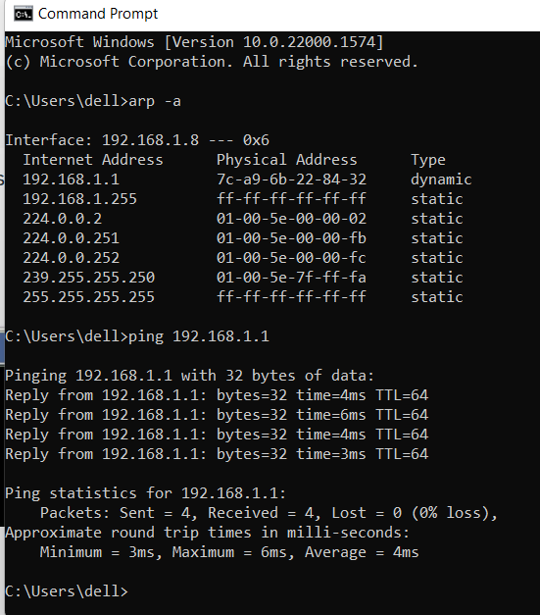
entries of the ARP table
https://www.youtube.com/watch?v=P7TPh1WuzNI

Slide 49
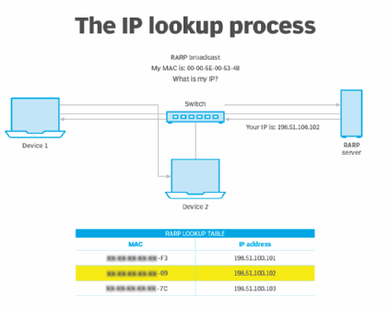
Reverse ARP (RARP)
It is a networking protocol used by the client system in a local area network (LAN) to request its IPv4 address from the ARP gateway router table/RARP server.
A table is created by the network administrator in the gateway-router that is used to find out the MAC address to the corresponding IP address.
When a new system is set up or any machine that has no memory to store the IP address, then the user has to find the IP address of the device. The device sends a RARP broadcast packet, including its own MAC address in the address field of both the sender and the receiver hardware.
A host installed inside of the local network called the RARP-server is prepared to respond to such type of broadcast packet. The RARP server is then trying to locate a mapping table entry in the IP to MAC address. If any entry matches the item in the table, then the RARP server sends the response packet along with the IP address to the requesting computer.
RARP was used on Ethernet, Fiber Distributed Data Interface and token ring LANs

Slide 50
Inverse ARP (InARP) -
Inverse ARP is inverse of the ARP, and it is used to find the IP addresses of the nodes from the data link layer addresses.
These are mainly used for the frame relays, and ATM networks, where Layer 2 virtual circuit addressing are often acquired from Layer 2 signaling.
Reverse ARP is same as Inverse ARP however it was mainly used for device configuration
Proxy ARP
Proxy ARP is a technique using which a proxy server on a given network answers the ARP queries for an IP address that is not on that network.

Slide 51
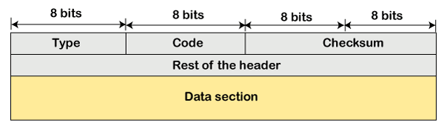
Internet Control Message Protocol(ICMP)
ICMP is used for reporting errors and management queries.
It is a supporting protocol and is used by networks devices like routers for sending error messages and operations information., e.g. the requested service is not available or that a host or router could not be reached.
Since IP does not have an inbuilt mechanism for sending error and control messages. It depends on Internet Control Message Protocol(ICMP) to provide an error control.
Type: It is an 8-bit field. It defines the ICMP message type. The values range from 0 to 127 are defined for ICMPv6, and the values from 128 to 255 are the informational messages.
Code: It is an 8-bit field that defines the subtype of the ICMP message
Checksum: It is a 16-bit field to detect whether the error exists in the message or not.

Slide 52
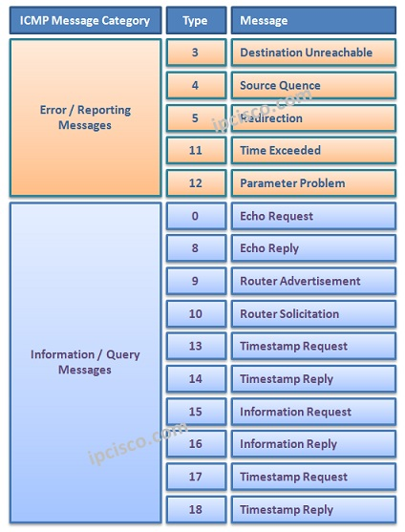

Slide 53
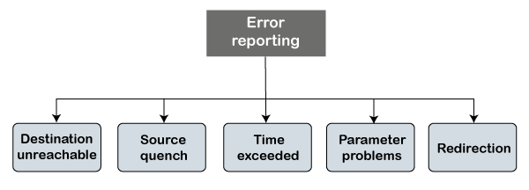
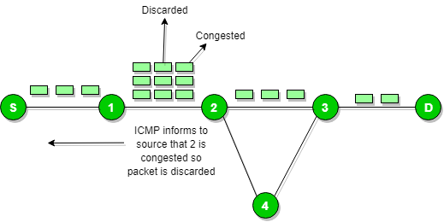
Types of Error Reporting messages
Source quench message :
ICMP provides feedback about flow control and congestion, i.e., source quench. Suppose the sender resends the packet at a higher rate, and the router is not able to handle the high data rate. To overcome such a situation, the router sends a source quench message to tell the sender to send the packet at a lower rate.

Slide 54
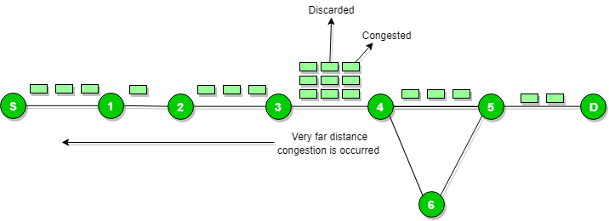
When the congestion router is far away from the source the ICMP will send hop by hop source quench message so that every router will reduce the speed of transmission.

Slide 55
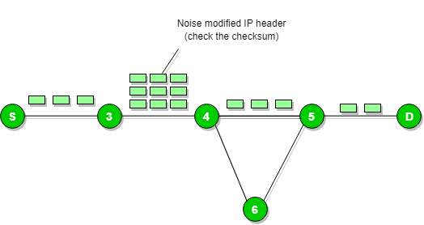
Parameter problem :
Whenever packets come to the router then the calculated header checksum should be equal to the received header checksum then the only the packet is accepted by the router.
If there is a mismatch packet will be dropped by the router.
ICMP will take the source IP from the discarded packet and informs to the source by sending a parameter problem message.

Slide 56
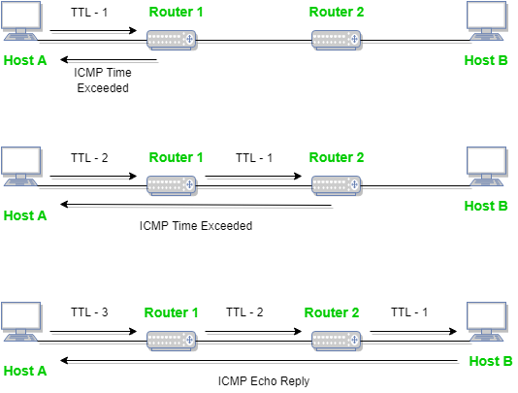
Time exceeded message
When some fragments are lost in a network then the holding fragment by the router will be dropped then ICMP will take the source IP from the discarded packet and informs the source, of discarded datagram due to time to live field reaches zero, by sending time exceeded message

Slide 57
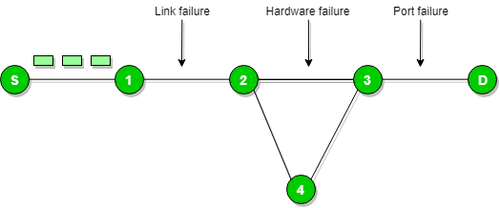
Destination un-reachable :
Destination unreachable is generated by the host or its inbound gateway to inform the client that the destination is unreachable for some reason
There is no necessary condition that the only the router gives the ICMP error message some time the destination host sends an ICMP error message when any type of failure (link failure, hardware failure, port failure, etc) happens in the network

Slide 58
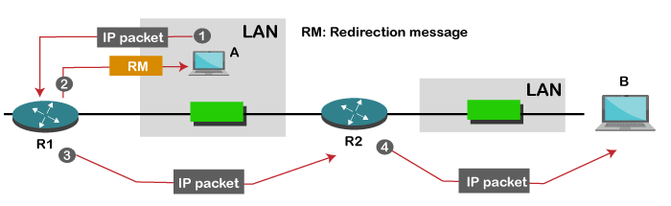
Redirection message :
Redirect requests data packets are sent on an alternate route. The message informs a host to update its routing information (to send packets on an alternate route).

Slide 59
ICMP Query Messages
The ICMP Query message is used for error handling or debugging the internet. This message is commonly used to ping a message.
Echo-request and echo-reply message
A router or a host can send an echo-request message. It is used to ping a message to another host that "Are you alive". If the other host is alive, then it sends the echo-reply message. An echo-reply message is sent by the router or the host that receives an echo-request message.
The echo-request message and echo-reply message can be used by the network managers to check the operation of the IP protocol
Timestamp-request and timestamp-reply message
The timestamp-request and timestamp-reply messages are also a type of query messages. Suppose the computer A wants to know the time on computer B, so it sends the timestamp-request message to computer B. The computer B responds with a timestamp-reply message
It can be used to calculate the round-trip time between the source and the destination, even if the clocks are not synchronized.
It can also be used to synchronize the clocks in two different machines if the exact transit time is known

Slide 60
Debugging tools
There are several tools used for debugging. In this topic, we will learn two tools that use ICMP for debugging. The two tools are ping and traceroute.
Traceroute is a tool that tracks the route taken by a packet on an IP network from source to destination.
It records the time taken by the packet on each hop during its route from source to destination.
Traceroute uses ICMP messages and TTL values. The TTL value is calculated; if the TTL value reaches zero, the packet gets discarded.
Traceroute uses small TTL values as they get quickly expired. If the TTL value is 1 then the message is produced by router 1; if the TTL value is 2 then the message is produced by router 2, and so on

Slide 61
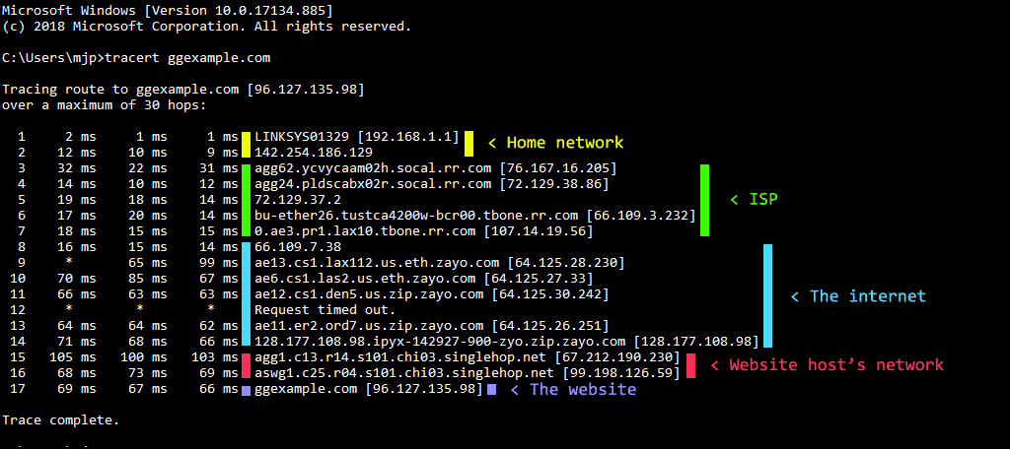
C:>tracert gexample.com

Slide 62
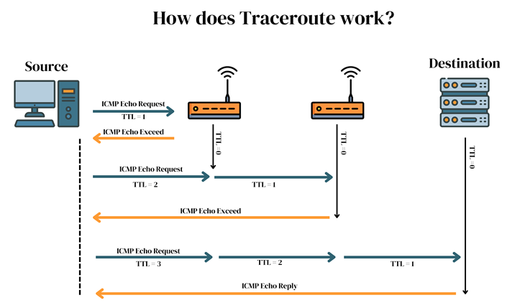

Slide 63
DHCP (Dynamic Host Configuration Protocol)
DHCP (Dynamic Host Configuration Protocol) is a network management protocol used to dynamically assign an IP address to any device, or node, on a network so it can communicate using IP.
DHCP automates and centrally manages these configurations rather than requiring network administrators to manually assign IP addresses to all network devices.
DHCP can be implemented on small local networks, as well as large enterprise networks.
DHCP assigns new IP addresses in each location when devices are moved from place to place, which means network administrators do not have to manually configure each device with a valid IP address or reconfigure the device with a new IP address if it moves to a new location on the network

Slide 64
DHCP supports three mechanisms
Automatic Allocation
DHCP assigns a permanent IP address to a host
Dynamic allocation
DHCP assigns a permanent IP address to a host for a specific period of time
Manual allocation
A host’s IP address is assigned by the network administrator, where DHCP is used to inform the address assigned to client
The DHCP process works as follows:
A client (network device) must be connected to the internet.
DHCP clients request an IP address. Typically, client broadcasts a query for this information.
DHCP server responds to the client request by providing IP server address and other configuration information. This configuration information also includes time period, called a lease, for which the allocation is valid.
When refreshing an assignment, a DHCP clients request the same parameters, but the DHCP server may assign a new IP address. This is based on the policies set by the administrator.

Slide 65
DHCP Operation
DCHP DISCOVER
DCHP OFFER

Slide 66
DHCP Operation
DCHP DISCOVER
At this time, the DHCP client can start to use the IP address
Renewing a Lease
(sent when 50% of lease has expired)
If DHCP server sends DHCPNACK, then address is released.

Slide 67
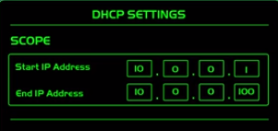
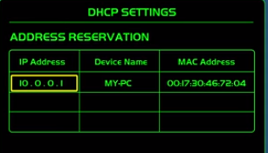
DHCP Operation
DCHP RELEASE
At this time, the DHCP client has released the IP address

Slide 68
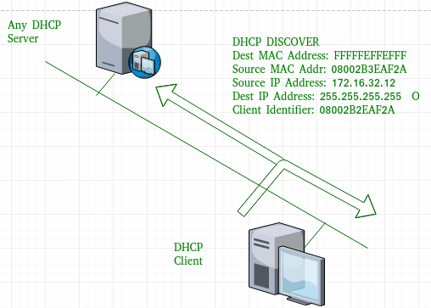
DHCP discover message
This message is generated by Client host in order to discover if there is any DHCP server/servers are present in a network or not.
This message is broadcasted to all devices present in a network to find the DHCP server. This message is 342 or 576 bytes long
source MAC address (client PC) is 08002B2EAF2A,
destination MAC address(server) is FFFFFFFFFFFF,
source IP address is 0.0.0.0(because PC has no IP address till now) and
destination IP address is 255.255.255.255 (IP address used for broadcasting).
As the discover message is broadcast to find out the DHCP server or servers in the network therefore broadcast IP address and MAC address is used

Slide 69
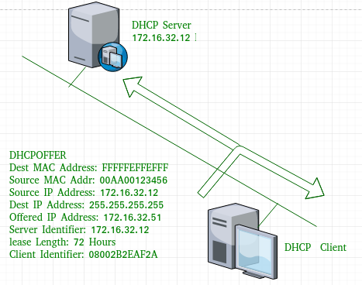
DHCP offer message
The server will respond to host in this message specifying the unleased IP address. This message is broadcasted by server. Size of message is 342 bytes.
If there are more than one DHCP servers present in the network then client host will accept the first DHCP OFFER message it receives. Also a server ID is specified in the packet in order to identify the server
offer message,
source IP address is 172.16.32.12 (server’s IP address in the example),
destination IP address is 255.255.255.255 (broadcast IP address) ,
source MAC address is 00AA00123456,
destination MAC address is FFFFFFFFFFFF.
Also the server has provided the offered IP address 192.16.32.51 and lease time of 72 hours(after this time the entry of host will be erased from the server automatically) .
Also the client identifier is PC MAC address (08002B2EAF2A) for all the messages

Slide 70
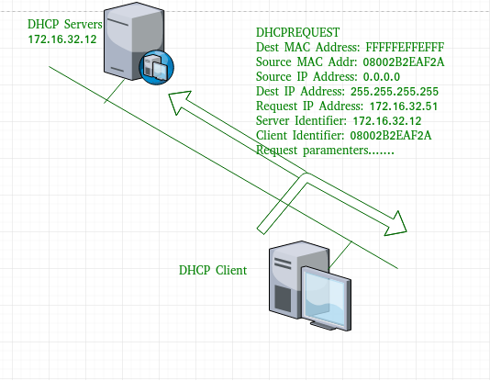
DHCP request message
When a client receives a offer message, it responds by broadcasting a DHCP request message.
The client will produce a gratuitous ARP in order to find if there is any other host present in the network with same IP address.
If there is no reply by other host, then there is no host with same TCP configuration in the network and the message is broadcasted to server showing the acceptance of IP address .
A Client ID is also added in this message

Slide 71
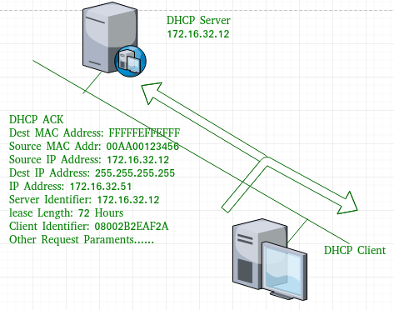
DHCP acknowledgement message
In response to the request message received, the server will make an entry with specified client ID and bind the IP address offered with lease time.
Now, the client will have the IP address provided by server.

Slide 72
DHCP negative acknowledgement message
Whenever a DHCP server receives a request for IP address that is invalid according to the scopes that is configured with, it send DHCP Nak message to client. Eg-when the server has no IP address unused or the pool is empty, then this message is sent by the server to client.
DHCP decline
If DHCP client determines the offered configuration parameters are different or invalid, it sends DHCP decline message to the server .When there is a reply to the gratuitous ARP by any host to the client, the client sends DHCP decline message to the server showing the offered IP address is already in use.
DHCP release
A DHCP client sends DHCP release packet to server to release IP address and cancel any remaining lease time.
DHCP inform
If a client address has obtained IP address manually then the client uses a DHCP inform to obtain other local configuration parameters, such as domain name.
In reply to the dhcp inform message, DHCP server generates DHCP ack message with local configuration suitable for the client without allocating a new IP address. This DHCP ack message is unicast to the client.

Slide 73
Components of DHCP
DHCP Server: DHCP server is a networked device running the DCHP service that holds IP addresses and related configuration information. This is typically a server or a router but could be anything that acts as a host, such as an SD-WAN appliance.
DHCP client: DHCP client is the endpoint that receives configuration information from a DHCP server. This can be any device like computer, laptop, IoT endpoint or anything else that requires connectivity to the network. Most of the devices are configured to receive DHCP information by default.
IP address pool: IP address pool is the range of addresses that are available to DHCP clients. IP addresses are typically handed out sequentially from lowest to the highest.
Subnet: Subnet is the partitioned segments of the IP networks. Subnet is used to keep networks manageable.
Lease: Lease is the length of time for which a DHCP client holds the IP address information. When a lease expires, the client has to renew it.
DHCP relay: A host or router that listens for client messages being broadcast on that network and then forwards them to a configured server. The server then sends responses back to the relay agent that passes them along to the client. DHCP relay can be used to centralize DHCP servers instead of having a server on each subnet

Slide 74
Advantages
centralized management of IP addresses
ease of adding new clients to a network
reuse of IP addresses reducing the total number of IP addresses that are required
simple reconfiguration of the IP address space on the DHCP server without needing to reconfigure each client
Disadvantages
IP conflict can occur
Not secure

